Slide 1
PROJECT BASED ON “RAT IN MAZE PROBLEM USING BACKTRACKING ALGORITHM”
DESIGN AND ANALYSIS OF ALGORITHMS

Slide 2
CONTENTS
INTRODUCTION | 1
PROBLEM STATEMENT AND OBJECTIVES | 2
Backtracking Algorithm | 3
Approach and algorithm for the problem | 5
Sample Problem | 8
Complexity Analysis | 10
Conclusion | 12
REFERENCES | 13

Slide 3
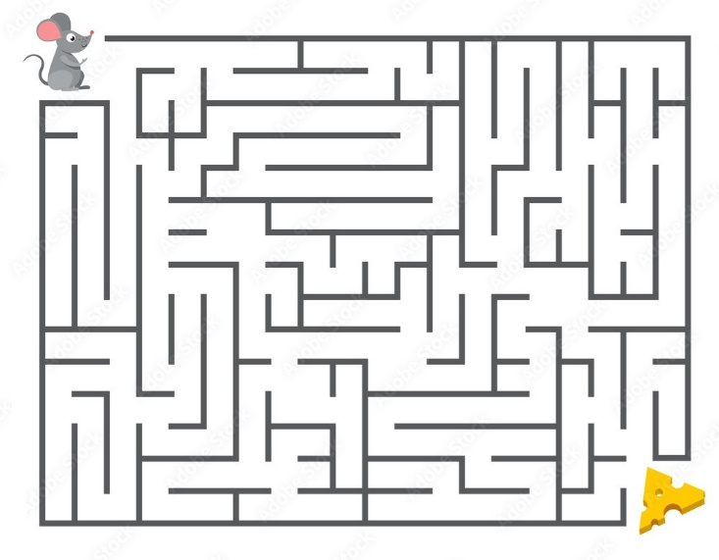
INTRODUCTION
You may remember the maze game from childhood where a player starts from one place and ends up at another destination via a series of steps. This game is also known as the rat maze problem.

Slide 4
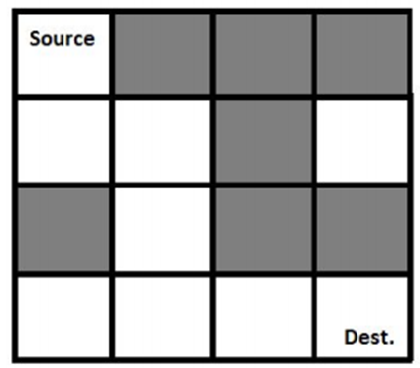
PROBLEM STATEMENT AND OBJECTIVES
In this problem, there is a given maze of size N x N. The source and the destination location is top-left cell and bottom right cell respectively. Some cells are valid to move and some cells are blocked. If one rat starts moving from start vertex to destination vertex, we have to find that is there any way to complete the path, if it is possible then mark the correct path for the rat.
The maze is given using a binary matrix, where it is marked with 1, it is a valid path, otherwise 0 for a blocked cell.
NOTE: The rat can only move in two directions, either to the right or to the down.

Slide 5
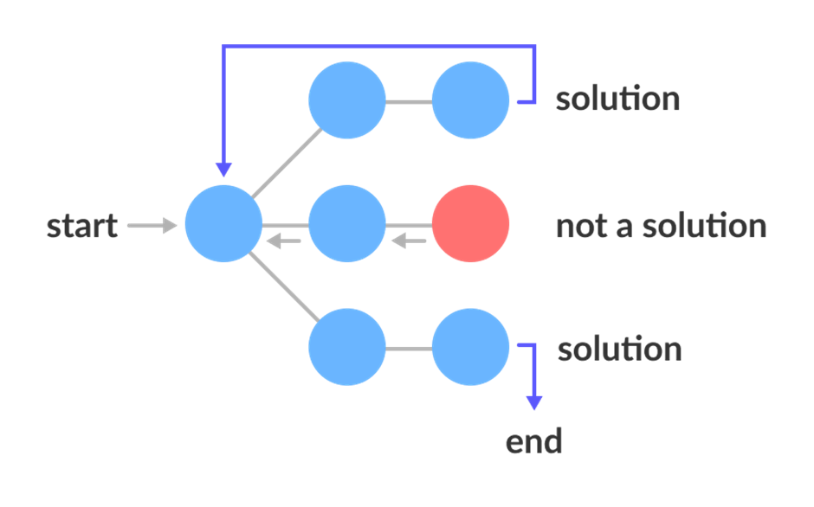
Backtracking Algorithm:
Backtracking is an algorithmic-technique for solving problems recursively by trying to build a solution incrementally. Solving one piece at a time, and removing those solutions that fail to satisfy the constraints of the problem at any point of time (by time, here, is referred to the time elapsed till reaching any level of the search tree) is the process of backtracking.

Slide 6
The term backtracking suggests that if the current solution is not suitable, then backtrack and try other solutions. Thus, recursion is used in this approach.
State Space Tree:
A space state tree is a tree representing all the possible states (solution or nonsolution) of the problem from the root as an initial state to the leaf as a terminal state.
Backtracking Algorithm:
Backtrack(x)
if x is not a solution
return false
if x is a new solution
add to list of solutions
backtrack(expand x)

Slide 7
APPROACH AND ALGORITHM FOR THE PROBLEM
Form a recursive function, which will follow a path and check if the path reaches the destination or not. If the path does not reach the destination then backtrack and try other paths.
Create a solution matrix, initially filled with 0’s.
Create a recursive function, which takes initial matrix, output matrix and position of rat (i, j).
if the position is out of the matrix or the position is not valid then return.
Mark the position output[i][j] as 1 and check if the current position is destination or not. If destination is reached print the output matrix and return.
Recursively call for position (i-1,j), (I,j-1), (i+1, j) and (i, j+1).
Unmark position (i, j), i.e output[i][j] = 0.

Slide 8
isValid(x, y)
Input: x and y point in the maze.
Output: True if the (x,y) place is valid, otherwise false.
Begin
if x and y are in range and (x,y) place is not blocked, then
return true
return false
End

Slide 9
solveRatMaze(x, y)
Input− The starting point x and y.
Output − The path to follow by the rat to reach the destination, otherwise false.
Begin
if (x,y) is the bottom right corner, then
mark the place as 1
return true
if isValidPlace(x, y) = true, then
mark (x, y) place as 1
if solveRatMaze(x+1, y) = true, then //for forward movement
return true
if solveRatMaze(x, y+1) = true, then //for down movement
return true
mark (x,y) as 0 when backtracks
return false
return false
End

Slide 10
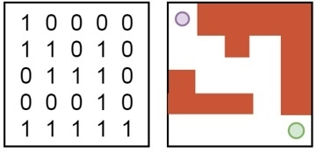
SAMPLE PROBLEM
Input:
This algorithm will take the maze as a matrix.
In the matrix, the value 1 indicates the free space and 0 indicates the wall or blocked area.
In this diagram, the top-left circle indicates the starting point and the bottom-right circle indicates the ending point.

Slide 11
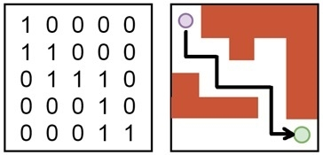
OUTPUT:
It will display a matrix. From that matrix, we can find the path of the rat to reach the destination point.

Slide 12
COMPLEXITY ANALYSIS:
Time Complexity: O(2^(n^2)). The recursion can run upper-bound 2^(n^2) times.
Space Complexity: O(n^2). Output matrix is required so an extra space of size n*n is needed.

Slide 14
CONCLUSION
Using Backtracking algorithm , rat in maze problem can be solved easily as it’s very intuitive to code, it is a step-by-step representation of a solution to a given problem, which is very easy to understand and it has got a definite procedure.
A backtracking algorithm makes an effort to build a solution to a computational problem incrementally. Whenever the algorithm needs to choose between multiple alternatives to the next component of the solution, it simply tries all possible options recursively step-by-step.

Slide 15
References
https://www.geeksforgeeks.org/rat-in-a-maze-backtracking-2/
https://www.codingninjas.com/blog/2020/09/02/backtracking-rat-in-a-maze/
https://www.tutorialspoint.com/Rat-in-a-Maze-Problem

Slide 16
THANK YOU
TEAM MEMBERS :
YASH VEER SINGH – RA2011003011176
AYUSH DOGRA- RA2011003011175
HITESH REDDY- RA2011003011163

